Slide 1


In-House Insight: What Counsels
Must Know to Stay Ahead
Katie Goulding, Brand IP Counsel
JLR

Slide 2
Use It or Lose It
In commercial practice, is “use it or lose it” misleading?

Slide 3
The Problem
Maxim | Reality
Stability | Consistency | Frequent brand evolution | Dynamic priorities
Backward looking | Dispute reactive | Preservation of rights | Forward-looking | Market reactive | Commercial enabler
Clean evidential trail | Fragmented, multi-channel use, different agencies, time-limited campaigns

Slide 4

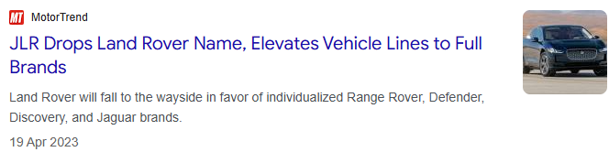




Example

Slide 5
Is it enough? Enough for what?
To Defend and Maintain
To reflect reality
To enable the future
Will our TM survive it? Which goods/services do we stand to lose?
Does the register (currently) correspond with brand activities?
What is the impact on our IPR?
What gaps need plugging?
What is the impact on the business?
How important is exclusivity?
Narrower enforceability? Exclusivity? Optionality?
Are we doing the right things now
to support the direction the brand will take?

Slide 6
From reactive collection to engineering evidence
Relationships are key: Evidence does not come from a single source: marketing, global insights teams, regional sales directors, PR teams, licensing teams, licensees, creative agencies, retailers, other third parties
Help build it: Treat change proposals as a trigger point – have conversations early and build forward-looking IP considerations into action (strategy, architecture, marketing and comms)
Consider the full-breadth of architecture: Enthusiast clubs, loyalty memberships, Classics division, collaborations (vintage, retro, re-purposed – control and/or royalty → commercial exploitation → evidenced by agreement)
Spot opportunity: Licence

Slide 7
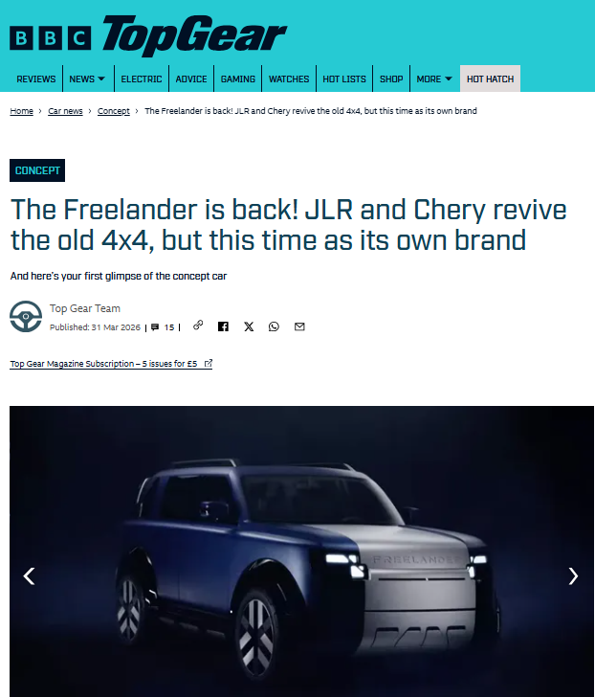

Slide 8


And if you can...
Capture transitions, not just end states – the public does not compare the version in use with the registered trade mark. They recognize a brand as it evolves. [But is the law fit for purpose?]
Record context, not just snapshots
File proactively, avoid reliance on stretched “acceptable variation” arguments
Build a narrative, not a list
Get access to tools used by other teams: sales data, media monitoring tools, insights reports, market studies

Slide 9
Use It or Lose It
Use it or lose it focuses on survival.
It protects the right.
In-house, the challenge is keeping it meaningful.
And it comes long before that proof of use deadline!

Slide 10
THANK YOU

